Slide 1
Module 5
Describing Families
RDA Training
University of Nevada, Reno
February 2013
Notes:
This module was taken from the draft NACO training for family names created by RLM in September 2012.

Slide 2
Please log in to RDA
http://access.rdatoolkit.org/?username=RDATraining&password=Wolfie13
Reno Workshop: Please feel free to sign up later for a month’s free access so you can practice (see handout)
Notes:
From now on, as I show slides of RDA, please feel free to go ahead and look yourself in the Toolkit.

Slide 3
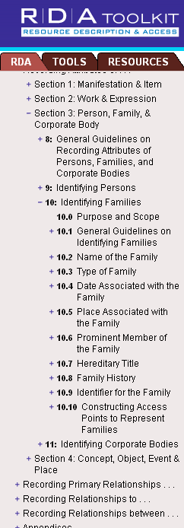
RDA Chapters 8 and 10
Notes:
Guidelines for describing families in authority records are found in RDA Chapters 8 and 10.

Slide 4
Families as creators
Families create records (archives)
Families create serials (e.g. newsletters)
Families create monographs (e.g. a family cookbook)
Families create Internet resources (e.g. family websites or blogs)
Notes:
Families can be creators of works in a number of ways, including those listed here.

Slide 5
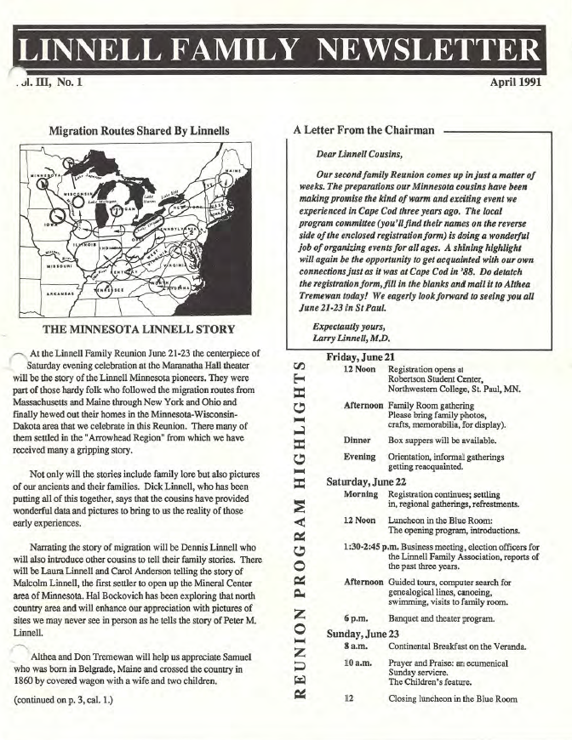
Serial
Notes:
[Source: http://www.linnellfamilyassociation.com/Newletters/April_1991.pdf]

Slide 6
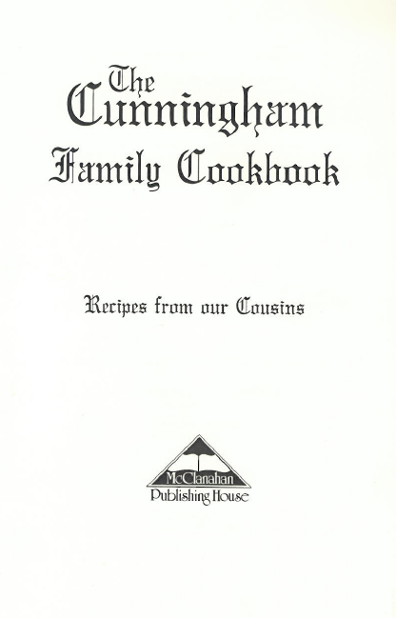
Monograph
Notes:
This is the title page.
This cookbook contains 400 recipies from Cunningham cousins, the descendants of William and Nancy Carr Cunningham of Trigg County, Kentucky, and includes photos and a brief family history. [from publisher’s advertisement at its website]
[Source: http://www.kybooks.com/index.php?act=viewProd&productId=9]

Slide 7
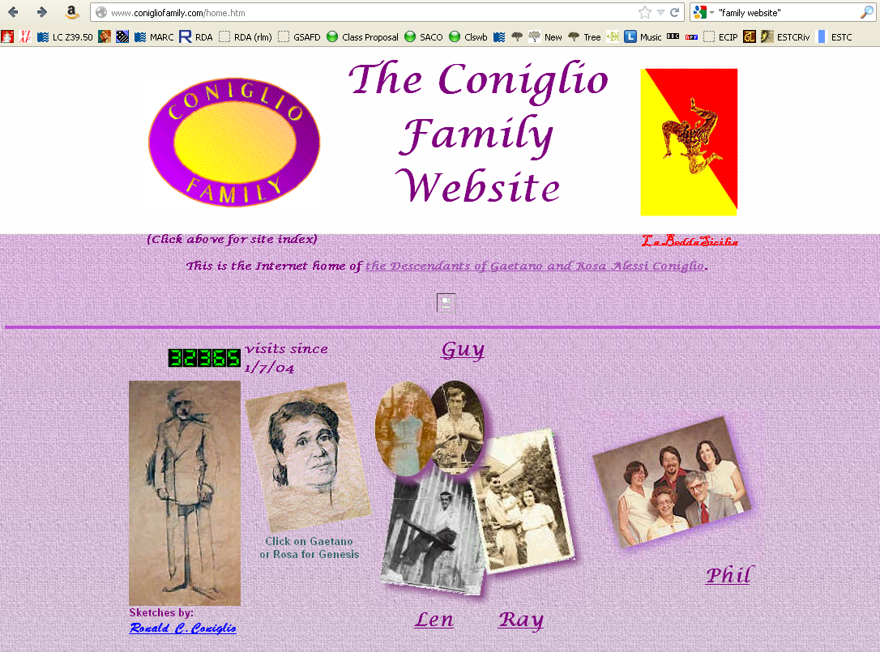
Website
Notes:
This is a website created by the family for the descendants of Gaetano and Rosa Alessi Coniglio.
[Source: http://www.conigliofamily.com/home.htm]

Slide 8
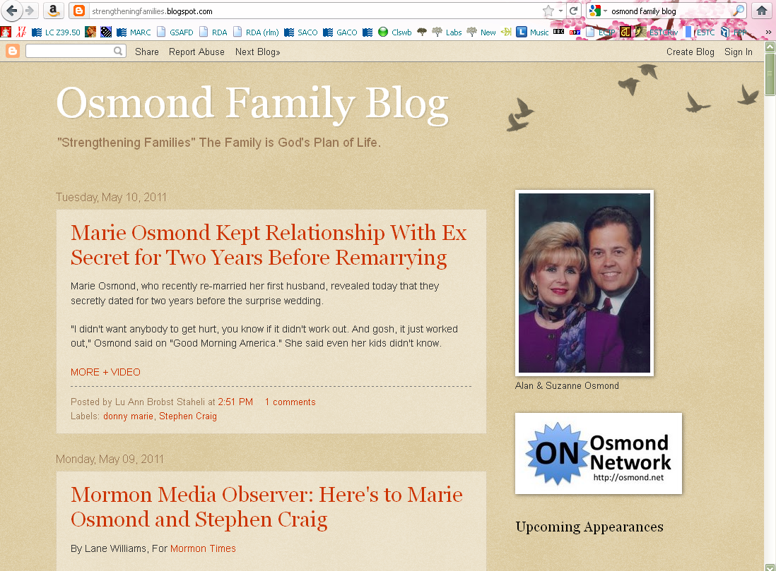
Blog

Slide 9
Families as contributors
Families can be contributors as well, for example, as
  Performers
  Publishers
  Owners
Notes:
In addition to these, there are many other ways families can be related to works, expressions, manifestations, or items.

Slide 10
Families as subjects
Families can also be subjects of works.
Current LC policy: only use LCSH family name forms in 600 fields, even in RDA records. This policy may change in the future.
Until the policy changes, family name records should be coded as not valid for use as subjects and should include
  667 $a SUBJECT USAGE: This heading is not valid for use as a subject; use a family name heading from LCSH.
Notes:
[RLM: I think the 667 should use the word “authorized access point” instead of “heading” the first time--the second time LCSH vocabulary still uses the word “heading.” Need to consult with LC on the wording.]

Slide 11
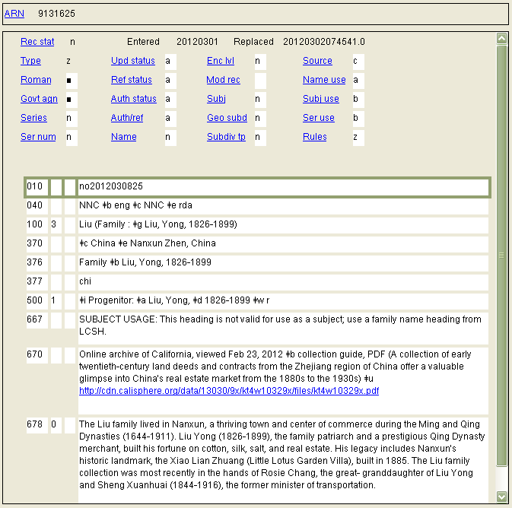
Notes:
This family is a creator of an archival collection.

Slide 12
MARC Coding
Familes are coded in X00 with first indicator “3”
As with other authority records, RDA records for families are coded “z” in 008/10 (“Rules”) and “rda” in 040 subfield $e.

Slide 13
Notes:
The Liu family again

Slide 14
Definition
RDA 8.1.2: The term family refers to two or more persons related by birth, marriage, adoption, civil union, or similar legal status, or who otherwise present themselves as a family.
Also includes larger groups such as dynasties, clans, or royal houses.

Slide 15
Family vs. Corporate Body
Families can be related to organizations. Such organizations are corporate bodies:
  100 3_ $a Hoopes (Family : $g Hoopes, Joshua, 1645-1723)
  110 2_ $a Hoopes Family Organization
  100 3_ $a Osmond (Family : $g Osmond, George, 1917-2007)
  110 2_ $a Osmonds (Musical group)
Notes:
Be careful to distinguish between a family entity and a corporate body entity, such as a family organization or singing group.

Slide 16
RDA Core Elements for Families
RDA 8.3
Always core if the information is known
  Preferred name for the family
  Type of family
  Date associated with the family
  Identifier for the family
Core if necessary to distinguish
  Place associated with the family
  Prominent member of the family
Notes:
Remember “core” does not necessarily mean the information has to become part of the authorized access point. It simply means it must be recorded as part of the description.

Slide 17
Exercise
What core elements can you identify about the Coniglio Family?
Notes:
See information on the following two slides about the Coniglio family.

Slide 18
Notes:
Do not attempt to code these in MARC at this point. We’re just looking for information.
Preferred name of the family (Coniglio) [note the word “family” is not considered part of the name in RDA]
Type of family (family)
Prominent member(s) of the family (Gaetano Coniglio, Rosa Alessi Coniglio). Note in this case the prominent members are also the progenitors of the family (see RDA Appendix K.2.2). This element is commonly used to record progenitors, but other prominent members of the family can also be recorded.
[Presenter: when finished here “click” on the picture of Gaetano or Rosa for more]
[Source: http://www.conigliofamily.com/home.htm]

Slide 19
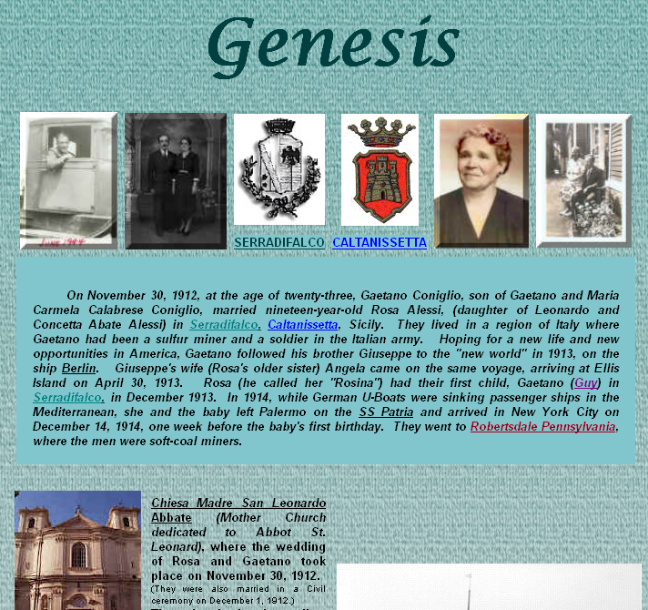
Notes:
Other core information:
Date associated with the family: November 30, 1912 (date of marriage, can be considered the date the familiy began); arrival in America (April 30, 1913)--cataloger judgment, but this might instead be considered the beginning of this particular American Coniglio family. A date of marriage if available might be more appropriate for most families that define themselves as the descendants of a couple.
Place(s) associated with the family: Serradifalco, Italy; Robertsdale, Pa.
[Source: http://www.conigliofamily.com/Genesis.htm]

Slide 20
Identifying Families: Transcription and Capitalization
8.5.1. Follow Appendix A.2
8.5.4. Diacritical marks: record them as they appear; add them if it is certain that they are integral to the name but were omitted in the source
8.5.5. Retain hyphens if used by the family
8.5.6. Instructions about spacing between initials
8.5.7. Abbreviations. Follow the usage of the familiy
8.4. Language and script. NACO policy = Romanize vernacular scripts.
Notes:
Go to 8.5.1; have someone read, especially 8.5.6.1. Then go to Appendix A.2 & B.2 and examine together.

Slide 21
RDA 8.12. Source Consulted
Record in 670 field, or 3XX $u/$v
Always include one 670 for the work being cataloged
Others included if needed to justify information in the description
Suggested format:
  670 $a Title proper, date: $b citation (data)
Notes:
Everyone go to RDA 8.12.

Slide 22
670 field examples
  670 $a Letters and papers of the Verney family down to the end of the year 1639
670 $a Diaspora in Buenos Aires, 2012: $b disc face (Linetzky Family)
670 $a Converted mind, 2011: $b CD case (the Manning family)
670 $a Warmed by the hearthstone, 2011: $b title page (the Moran family)
670 $a OCLC, June 16, 2012 $b (usage: Atholl family)
Notes:
Explain the OCLC 670.
There are lots of ways to form these. The point is, record information justifying what you’ve included in other elements in the description.

Slide 23
Identifying Families: Sources
Where can we get information about persons?
  10.1.1: Take the name or names of the family from any source; take information on other identifying attributes from any source.

Slide 24
Identifying Families: Sources
Sources to check
  The resource you are cataloging
  The LC/NACO Authority File (authorities.loc.gov)
  Your database (e.g. OCLC)
  Optional: Other useful sources
    Virtual International Authority File (http://viaf.org)
    Wikipedia (http://www.wikipedia.org/)
    Other sources such as encyclopedias and dictionaries
    FamilySearch.org
    ancestry.com

Slide 25
Choosing and Recording the Preferred Name
Preferred name is a core element
The preferred name should be the commonly known form of the name (RDA 10.2.2).
Forms found in preferred sources of information (e.g. title pages of books) are assumed to be the commonly known form, but other evidence may contradict this.
Notes:
Read RDA 10.2.2.3 together, then 10.2.2.2. The basic guideline is 10.2.2.3, especially the first sentence; 10.2.2.2 is the default; RDA assumes that forms found in preferred sources of information are the commonly known forms, so such sources have greater weight than others. However, the cataloger must weigh all the available evidence.
Reminder if needed (if this module is being given independently, or if the reminder hasn’t already been given in a previous module such as personal names)-- Have a look at RDA 2.2.2 to see what the preferred sources of information are. The preferred source of information for a website (for the Coniglio family) is found in 2.2.2.4: embedded metadata (which would include just about everything in the website, including wording on the title page) or any source “forming part of the resource itself.”

Slide 26
Preferred Name Chosen from Preferred Sources
Linnell
Cunningham
Notes:
Title page of the Cunningham Family Cookbook. Publication date = 1997.
[Source: http://www.linnellfamilyassociation.com/Newletters/April_1991.pdf] Note: for 670, the first newsletter was March 1989.
[Source: http://www.kybooks.com/index.php?act=viewProd&productId=9]

Slide 27
Attributes of Persons: Preferred Name (MARC)
Most RDA entity attributes have a discrete place in MARC to record them. Preferred name does not. It can only be recorded as part of the authorized access point for the family.
Record in the MARC authorities format 100 field, first indicator 3.
Record the preferred name in subfield $a.
Notes:
LOOK AT MARC authority format 100 field.

Slide 28
Preferred Name (RDA 10.2.2)
The preferred name is recorded in direct order in the 100 field of the authority record
100 3_ $a Duvall
100 3_ $a Larsen
Record the preferred names for the three families we have worked on so far on your work forms
Notes:
They should record
100 3_ $a Coniglio
100 3_ $a Linnell
100 3_ $a Cunningham

Slide 29
Preferred Name (RDA 10.2.2)
Different forms of the same name (10.2.2.5)
If family names vary in fullness, language, script, or spelling, follow the instructions for personal names (9.2.2)
  Valera y Alcalá Galiano vs. Valera
  Knef vs. Neff
  Melanchthon vs. Schwarzerd
  Kohen-Asif vs. כהן־אסיף

Slide 30
Preferred Name (RDA 10.2.2)
Different names for the same family (10.2.2.6)
If family goes by different names and has not changed its name, choose the most commonly known form
  Bonello vs. Tal Korkos
  Conte vs. Tamburra
  Amirault vs. Tourangeau
Notes:
Bonello vs. Tal Korkos: a Maltese surname and a family nickname [source: http://www.maltainsideout.com/1531/whats-in-a-name-a-lot-if-its-malta/]
Conte vs. Tamburra: an Italian surname and a soprannome [source: http://www.laroccalulett.com/Nicknames.html]
Amirault vs. Tourangeau: an Acadian surname and a “dit” name [source: http://www.eogen.com/acadianditnames]

Slide 31
Preferred Name (RDA 10.2.2)
Change of name (10.2.2.7)
If a family changes its name, create a new record for the new name. Use the earlier form with resources associated with it; and the later form with resources associated with it.
Similar to corporate body name change.
    Battenberg => Mountbatten
Notes:
Because of anti-German sentiment the Battenberg family changed its name to Mountbatten on 14 July 1917. [Source: http://en.wikipedia.org/wiki/Mountbatten]
The House of Windsor is the royal house of the United Kingdom and the other Commonwealth realms. It was founded by King George V by royal proclamation on 17 July 1917, when he changed the name of his family from the German Saxe-Coburg and Gotha (a branch of the House of Wettin) to the English Windsor, due to the anti-German sentiment in the British Empire during World War I. [Source: http://en.wikipedia.org/wiki/House_of_Windsor]

Slide 32
Preferred Name (RDA 10.2.2)
Treatment of surnames (10.2.2.8)
Compound surnames and surnames with separately written prefixes are treated the same as for personal names (9.2.2.10-12)
  Lloyd George not George
  Von Braun vs. Braun [depends on nationality]
  D’Anvers vs. Anvers [depends on nationality]

Slide 33
Variant name (RDA 10.2.3)
The same types of variants can occur for family names as occur for personal names
Variant names are recorded in subfield $a of a MARC 400 field
  100 3_ $a Carragher ...
  400 3_ $a Caragher ...
  400 3_ $a Caraher ...
  400 3_ $a Carraher ...
Notes:
NOTE: These are not the same as LCSH family authority records. Do NOT add variants found there.

Slide 34
Type of Family (RDA 10.3)
Type of family is defined as “a categorization or generic descriptor for the type of family.”
  Family
  Clan
  Tribe
  Sept
  Dynasty
  Kindred group
The type of family element is core (required)
Notes:
Since this is a new concept to most, carefully read the definition.

Slide 35
Type of Family (RDA 10.3)
Record Type of Family as an element in 376 subfield $a
376 $a Family
It is also included in the authorized access point (in the same subfield $a as the preferred name)
100 3 $a Johnson (Family ...
100 3 $a MacPherson (Clan ...
Notes:
The Type of Family element should be recorded in a 376 field and is a required part of the authorized access point. Other elements may be included at the discretion of the cataloger. At least enough elements must be included to distinguish the family from others with the same name and type of family, but the choice of the distinguishing elements is up to the cataloger’s judgment.

Slide 36
Type of Family (RDA 10.3)
Record the type of family element in your worksheets
Notes:
They should record
100 3_ $a Cunningham (Family
376 $a Family
100 3_ $a Coniglio (Family
376 $a Family
100 3_ $a Linnell (Family
376 $a Family

Slide 37
Date Associated with the Family (RDA 10.4)
The Date Associated with the Family element is also core, but often unknown.
  Might be marriage date of an ancestor couple
  Might be birth of first child of an ancestor couple
  Might be a date of immigration of an ancestor
  Includes dates of dynasties, royal houses, etc.
Notes:
Note the dates do not necessarily need to be precise--for example, with a dynasty, especially one far back in history, dates might be approximate, such as a century or range of centuries.

Slide 38
Date Associated with the Family (RDA 10.4)
If known, this element must be recorded. It is recorded in the 046 field ($s is the beginning date, $t is the end)
046 $s 1811
Also included in the authorized access point
100 3 $a MacIntosh (Family : $d 1811- )

Slide 39
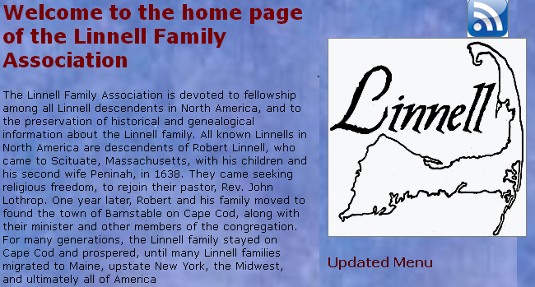
Further information about the Linnell family, from the Linnell Family Association website:
Notes:
[Source: http://www.linnellfamilyassociation.com/]

Slide 40
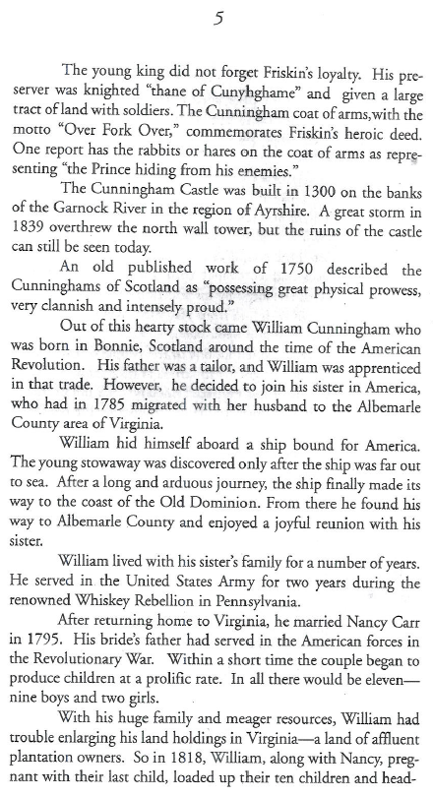
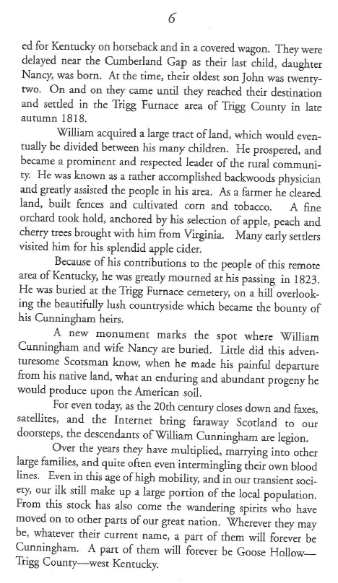
Further information about the Cunningham family, from p. 5-6 of the book
Notes:
Information:
Head of family: William Cunningham & Nancy Carr
William immigrated to the U.S. from Scotland after 1785, married Nancy Carr in 1795 in Virginia.
The family moved to Trigg County, Kentucky in 1818, where the family remained.
It’s clear from this preface that the Cunningham Family in this context refers to the descendents of William and Nancy Cunningham of Trigg County, Kentucky.

Slide 41
Date Associated with the Family (RDA 10.4)
Record the Date Associated with the Family element(s) for the Linnell, Cunningham, and Coniglio families in 046
Notes:
Information about Coniglio dates is on slide 18; about Linnell on slide 32; about Cunningham on slide 33.
046 $s 1795 [or you might choose 1818, when they arrived in Kentucky]
100 3_ $a Cunningham (Family : $d 1795-
376 $a Family
046 $s 19121130 [or 19130430]
100 3_ $a Coniglio (Family : $d 1912- [or 1913-]
376 $a Family
046 $s 1638
100 3_ $a Linnell (Family : $d 1638-
376 $a Family

Slide 42
Place Associated with the Family (RDA 10.5)
The Place Associated with the Family element is recorded in the 370 field
370 $c Australia
It may also be included in the authorized access point (but only required if needed to distinguish)
100 3 $a Boyd (Family : $c Australia)
Notes:
Record the place name in the same form in the access point as in the 370; if the guidelines call for abbreviations, abbreviate (e.g. “U.S.”).

Slide 43
Recording the Place Attribute
Place is recorded in MARC 370
  Associated country $c
  Place of residence $e
  Other associated place $f
Notes:
LOOK AT MARC

Slide 44
Recording the Place Attribute
The form of the place name is governed by RDA Chapter 16.
Authorized access points for jurisdictional place names are generally formed as in AACR2, e.g. “Paris (France)” However:
16.2.2.4. “If the place name is being used to record ... a place associated with a ... corporate body ... precede the name of the larger place by a comma.” -- e.g. “Paris, France”
Notes:
Important Reminder from the earlier session

Slide 45
Recording the Place Attribute
11.3.1.3 instructs us to follow chapter 16, including abbreviations; chapter 16 refers us to Appendix B.
B.11 is similar to the place names abbreviations list in AACR2
So when recording this attribute for a corporate body, use, e.g., “U.S.”, not “United States.”
Notes:
LOOK at B.11

Slide 46
Recording the Place Attribute
370 $e London, England [place of residence]
370 $f Mexico City, Mexico [other associated place]
370 $e Austin, Tex. [place of residence]
370 $f Ontario, Calif. [other associated place]
370 $e Ariz. [place of residence]
370 $e D.C. [place of residence]
370 $c U.S. [associated country]
370 $e Auckland, N.Z. $f P.R. $c France
[place of residence, other associated place, associated country]
Notes:
Remember for the moment we are required to use forms as established using the English rules. Note that 370 can be repeated, or alternately subfields can be repeated within a single 370.

Slide 47
Place Associated with the Family (RDA 10.5)
Record the Place Associated with the Family element(s) for the Cunningham, Linnell and Coniglio families in 370
Notes:
Don’t add anything to the authorized access point yet. You can record more than one place associated with the family.
Information about Coniglio dates is on slide 18; about Linnell on slide 32; about Cunningham on slide 33.
046 $s 1795
100 3_ $a Cunningham (Family : $d 1795-
370 $f Trigg County, Ky. $s 1818 [NOTE the date]
376 $a Family
046 $s 19121130 [or 19130430]
100 3_ $a Coniglio (Family : $d 1912-
370 $f Serradifalco, Italy $f Robertsdale, Pa.
376 $a Family
046 $s 1638
100 3_ $a Linnell (Family : $d 1638-
370 $f North America $f Cape Cod (Mass.) $2 lcsh
370 $f Scituate, Mass. $f Barnstable, Mass. $f Mass. $c U.S. [all possible, probably not all would be on any one]
376 $a Family

Slide 48
Prominent Member of the Family (RDA 10.6)
The Prominent Member of the Family element is recorded in the 376 field subfield $b with no internal subfield coding. Use the established form of a personal name.
376 $a Family $b Nibley, Hugh, 1910-2005
It may also be included in the authorized access point (but only required if needed to distinguish)
100 3 $a Nibley (Family : $g Nibley, Hugh, 1910- 2005)

Slide 49
Prominent Member of the Family (RDA 10.6)
Record the Prominent Member of the Family element(s) for the Cunningham, Linnell and Coniglio families in 376 subfield $b
Notes:
Don’t add anything to the authorized access point yet. You can record more than one prominent member associated with the family.
Information about Coniglio is on slide 18; about Linnell on slide 32; about Cunningham on slide 33.
Robert Linnell’s birth and death dates are 1584-1662. The form is the established form of the name, but you are not required to establish the name in order to record it in 376. If a relationship link is recorded between the family and the person (500 field, see below), however, the person’s name will need to be established.
William Cunningham’s dates are 1765-1823; Nancy (Carr) Cunningham’s dates are 1776-1830?
046 $s 1795
100 3_ $a Cunningham (Family : $d 1795-
370 $f Trigg County, Ky.
376 $a Family $b Cunningham, William, 1765-1823 $b Cunningham, Nancy, 1776-1830?
046 $s 19121130 [or 19130430]
100 3_ $a Coniglio (Family : $d 1912-
370 $f Serradifalco, Italy $f Robertsdale, Pa.
376 $a Family $b Coniglio, Gaetano $b Coniglio, Rosa [or Alessi, Rosa, depending on how it would be established]
046 $s 1638
100 3_ $a Linnell (Family : $d 1638-
370 $f North America $f Cape Cod (Mass.) $2 lcsh
370 $f Scituate, Mass. $f Barnstable, Mass. $f Mass. $c U.S. [all possible, probably not all would be on any one]
376 $a Family $b Linnell, Robert, 1584-1662

Slide 50
Hereditary Title (RDA 10.7)
Record a hereditary title associated with the family in direct order and in the plural in 376 subfield $c. The title is not part of the authorized access point.
  100 3_ $a Shrewsbury (Family : $c Great Britain)
  376 $a Family $c Earls of Shrewsbury
Notes:
Some information about the Earls of Shrewsbury: http://www.hereditarytitles.com/Page24.html

Slide 51
Family History (RDA 10.8)
A brief family history may be recorded in a 678 field, with first indicator coded “0”. This element may also be used to define the scope of the family.
  678 0_ $a The Linnell family consists of all Linnells in North America, all presumed to be descendants of Robert Linnell (1584-1662) who settled in Massachusetts in 1638.

Slide 52
Family History (RDA 10.8)
Exercise: Record a Family History element for the Coniglio or Cunningham family in 678

Slide 53
Identifier (RDA 10.9)
A character string uniquely associated with a person or an authority record
LCCN associated with an authority record is an identifier, recorded in 010
The element is core, but it is usually added to record automatically
Notes:
Look at RDA 9.18 together

Slide 54
Constructing the Authorized Access Point (RDA 10.10.1)
1. Record the Preferred name in subfield $a of the 100 field
100 3_ $a Coniglio
2. Add the type of family following an opening parenthesis
100 3_ $a Coniglio (Family

Slide 55
Constructing the Authorized Access Point (RDA 10.10.1)
3. Following space-colon-space $d, add the Date Associated with the Family element, if one was recorded. Normally record only the year(s).
100 3_ $a Coniglio (Family : $d 1912-

Slide 56
Constructing the Authorized Access Point (RDA 10.10.1)
4. Following space-colon-space, add the Place and/or Prominent Member element if necessary to distinguish from another access point, of if it assists in identifying the family
  A place is recorded in subfield $c
    100 3_ $a Coniglio (Family : $d 1912- : $c Robertsdale, Pa.)
  A prominent member is recorded in subfield $g
    100 3_ $a Coniglio (Family : $d 1912- : $g Coniglio, Gaetano, 1889-1944)
Notes:
Two possible ways to establish the Coniglio family name. It would also be possible to use Rosa as the prominent member if it was judged that she was more prominent than Gaetano or would better identify the family. Similarly, Serradifalco, Italy might have been chosen for the place. If it is thought necessary, different versions of the qualifier can be recorded in variant access points for the family.
Probably best not to go beyond 3 elements in the qualifier, even though RDA does not limit. You can always add variant access points to bring out other elements in the qualifier.

Slide 57
Constructing a Variant Access Point (RDA 10.10.2)
1. Record a variant name for the family in 400 subfield $a (and $c if necessary)
2. Following an opening parenthesis, add a term indicating the type of family
    100 3_ $a Shrewsbury (Family : $c Great Britain)
    400 3_ $a Shrewsbury, $c Earls of (Family)
    100 3_ $a Von Braun (Family : $d 1880-1912 : $c N.Y.)
    400 3_ $a Braun (Family)
Notes:
Note (to bring up only if somebody in the class notices): the RDA to MARC mapping in the Toolkit doesn’t take into account the situation found with the Shrewsbury 400; it only maps type of family to $a, but in this case it winds up in $c.

Slide 58
Constructing the Variant Access Point (RDA 10.10.2)
3. If considered important for identification of the family, add date, place, or prominent member elements.
    100 3_ $a Shrewsbury (Family : $c Great Britain)
    400 3_ $a Shrewsbury, $c Earls of (Family : $c Great Britain)
    100 3_ $a Von Braun (Family : $d 1880-1912 : $c N.Y.)
    400 3_ $a Braun (Family : $d 1880-1912 : $c N.Y.)
Notes:
This is completely up to the judgment of the cataloger. The only required elements in the variant access point are variant name and type of family.

Slide 59
Constructing the Variant Access Point (RDA 10.10.2)
Variant access points in which the qualifier varies may also be recorded, if thought necessary for identification
      100 3_ $a Coniglio (Family : $d 1912- : $c Robertsdale, Pa.)
      400 3_ $a Coniglio (Family : $d 1912- : $c Coniglio, Gaetano, 1889-1944)

Slide 60
Reminder: Source Consulted
RDA 8.12.1.3. Cite sources used to determine a preferred or variant name, followed by a brief statement of the information found. Identify the specific location within the source where the information was found.
RDA examples reflect NACO practice. Sources consulted are recorded in MARC 670 fields.
Notes:
Record the sources consulted on your worksheet (go back to the TP slide and the Wikipedia slide).
Coniglio—Slide 18
Linnell—Slide 32
Cunningham—Slide 33

Slide 61
Related Persons (RDA 30)
Related persons are recorded in 500 fields, and may include a relationship indicator in subfield $i (from RDA Appendix K), with $w r.
    046 $s 19121130
    100 3_ $a Coniglio (Family : $d 1912- : $c Robertsdale, Pa.)
    370 $f Serradifalco, Italy $f Robertsdale, Pa.
    376 $a Family $b Coniglio, Gaetano $b Coniglio, Rosa
    500 1_ $w r $i Progenitor: $a Coniglio, Gaetano, 1889-1944
    500 1_ $w r $i Progenitor: $a Coniglio, Rosa, 1893-
Notes:
Good way to check yourself is to use the phrase: [Relator designation]is [name]. This may help you determine if your are using the correct relator designation

Slide 62
Related Families (RDA 31)
Related families are also recorded in 500 fields. You may include a relationship indicator in subfield $i (from RDA Appendix K), with $w r, or may use MARC $w coding.
      100 3_ $a Battenberg (Family : $d -1917 : $c Great Britain)
      500 3_ $w b $a Mountbatten (Family : $d 1917- : $c Great Britain)
      100 3_ $a Mountbatten (Family : $d 1917- : $c Great Britain)
      500 3_ $w a $a Battenberg (Family : $d -1917 : $c Great Britain)
Notes:
In this case, since there isn’t yet an earlier-later relationship designator in Appendix K, we need to use the MARC $w coding.

Slide 63
Related Corporate Bodies (RDA 32)
Related corporate bodies are recorded in 510 fields. You may include a relationship indicator in subfield $i (from RDA Appendix K), with $w r, or may use MARC $w coding.
  100 3_ $a Linnell (Family : $d 1638- : $c North America)
  510 2_ $w r $i Founded organization: $a Linnell Family Association

Slide 64
Exercise
Complete the authority records for the Cunningham, Coniglio and Linnell families
Notes:
Possible answers coming up on following slides.

Slide 65
RDA authority record core and non-core
040 $a UPB $b eng $c UPB $e rda
046 $s 1795
100 3_ $a Cunningham (Family : $d 1795- : $c Trigg County, Ky.) [or record prominent member]
370 $f Trigg County, Ky. $s1818
376 $a Family $b Cunningham, William, 1765-1823 $b Cunningham, Nancy, 1776-1830?
[possible 400s]
400 3_ $a Cunningham (Family : $d 1795- : $g Cunningham, William, 1765-1823)
400 3_ $a Cunningham (Family : $d 1795- : $g Cunningham, Nancy, 1776-1830?)
500 1_ $w r $i Progenitor: $a Cunningham, William, $d 1765-1823
500 1_ $w r $i Progenitor: $a Cunningham, Nancy, $d 1776-1830?
670 $a The Cunningham family cookbook, 1997: $b p. 5-6 (descendants of William and Nancy Cunningham. William emigrated from Scotland some time after 1785 and married Nancy Carr in 1795. The family eventually settled in Trigg County, Ky.)
678 0_ $a The Cunningham family consists of descendants of William and Nancy Cunningham, who married in 1795 and later settled in Trigg County, Ky.
Notes:
Note very little is core or required in an RDA record. Institutions may declare other elements to be core. For example, the first source consulted (670) is core for PCC. (Language of cataloging is marked in the index as core but not in the rules themselves)

Slide 66
RDA authority record core and non-core
040 $a UPB $b eng $c UPB $e rda
046 $s 19121130 [or 19130430]
100 3_ $a Coniglio (Family : $d 1912- : $g Coniglio, Gaetano, 1889-1944) [or use Rosa, or use a place]
370 $f Serradifalco, Italy $f Robertsdale, Pa.
376 $a Family $b Coniglio, Gaetano $b Coniglio, Rosa [or Alessi, Rosa, depending on how it would be established]
[possible 400s]
400 3_ $a Coniglio (Family : $d 1912- : $g Coniglio, Rosa, 1893-)
400 3_ $a Coniglio (Family : $d 1912- : $c Robertsdale, Pa.)
400 3_ $a Coniglio (Family : $d 1912- : $c Serradifalco, Italy)
500 1_ $w r $i Progenitor: $a Coniglio, Gaetano, $d 1889-1944
500 1_ $w r $i Progenitor: $a Coniglio, Rosa, $d 1893-
670 $a The Coniglio family website, [date of viewing] $b (Coniglio family, descendants of Gaetano and Rosa Alessi Coniglio, who married 30 November 1912 in Serradifalco, Italy and emigrated to the United States 30 April 1913; the family settled in Robertsdale, Pa.)
678 0_ $a Gaetano and Rosa Coniglio founded the Coniglio family in 1912. The family later settled in Robertsdale,Pa.
Notes:
Note very little is core or required in an RDA record. Institutions may declare other elements to be core. For example, the first source consulted (670) is core for PCC. (Language of cataloging is marked in the index as core but not in the rules themselves)

Slide 67
RDA authority record core and non-core
040 $a UPB $b eng $c UPB $e rda
046 $s 1638
100 3_ $a Linnell (Family : $d 1638- $c North America)
370 $f North America $f Cape Cod (Mass.) $2 lcsh
370 $f Scituate, Mass. $f Barnstable, Mass. $f Mass. $c U.S. [all possible, probably not all would be on any description]
376 $a Family $b Linnell, Robert, 1584-1662
[some of the possible 400s]
400 3_ $a Linnell (Family : $d 1638- $c Cape Cod (Mass.))
400 3_ $a Linnell (Family : $d 1638- $g Linnell, Robert, 1584-1662)
500 1_ $w r $i Progenitor: $a Linnell, Robert, $d 1584-1662
  510 2_ $w r $i Founded organization: $a Linnell Family Association
670 $a Linnell family newsletter, 1989-
670 $a Linnell Family Association website, [date of viewing] $b (The Linnell family consists of all Linnells in North America, all presumed to be descendants of Robert Linnell, who came to Sciutate, Massachusetts with his children and second wife in 1638. The family later settled on Cape Cod.
  678 0_ $a The Linnell family consists of all Linnells in North America, all presumed to be descendants of Robert Linnell (1584-1662) who settled in Massachusetts in 1638.
Notes:
Note very little is core or required in an RDA record. Institutions may declare other elements to be core. For example, the first source consulted (670) is core for PCC. (Language of cataloging is marked in the index as core but not in the rules themselves)

Slide 68
Exercises
Create descriptions for other names associated with books you have brought
We can do some of these together in the LC/NACO Authority File

Slide 69
Module 5
Describing Families
Questions?
RDA Training
University of Nevada, Reno
February 2013

Slide 70
This Presentation is available at
http://net.lib.byu.edu/~catalog/people/rlm/RDAReno201302/index.htm
For further information
contact Robert L. Maxwell
robert_maxwell@byu.edu

